Slide 1
HARDWARE COMPONENTS
Instructor: john ortiz
Lecturer III utsa
stego@satx.rr.com
CS 3843 computer organization

Slide 2
Logical Operations Review
NOT
Invert all the bits
One’s complement
(N) AND
All inputs must be 1 for result to be one
Think multiplication: 1 * 1 * 1 * 1 * … if any one of the inputs is a zero, the result is zero
For NAND, same thing except result is inverted
If any one of the inputs is a zero, the result is a one

Slide 3
Logical Operations Review
(N) OR
If any input is a one, the result is a one
Think addition, but the result is either zero or not zero
In order for the final result to be zero, all inputs must be zero
For NOR, same thing except result is inverted
In order for the final result to be one, all inputs must be zero
(XOR / XNOR)
If both inputs are the same, the result is zero
Think even vs. odd – even number of ones, result is zero
XNOR is also called “equivalence” because if the inputs are the same , the result is a one

Slide 4
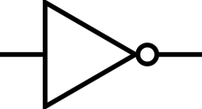
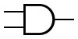
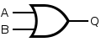
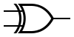
Logical Operations Review
Bitwise logical operations
Operates on each bit as specified below
NOT
! 0 = 1
! 1 = 0
AND OR
0 & 0 = 0 0 & 0 = 0
0 & 1 = 0 0 & 1 = 1
1 & 0 = 0 1 & 0 = 1
1 & 1 = 1 1 & 1 = 1
XOR
0 & 0 = 0
0 & 1 = 1
1 & 0 = 1
1 & 1 = 0

Slide 5
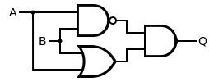
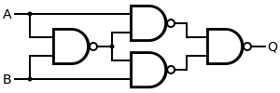
The XOR Gate
An XOR gate can be constructed from basic logical operations such as the two examples below
A | B | OUT
0 | 0 | 0
1 | 0 | 1
0 | 1 | 1
1 | 1 | 0

Slide 6
Hardware Logic
A brief look at the hardware that makes a computer work is based on the logical functions:
NOT
inverter
(N) AND
Enable / disable - (a one on one input enables the other)
Mask bits: AND a register with 0x0000000F and all bits except bottom 4 are zero – i.e. masked off
(N) OR
Enable / disable - (a zero on one input enables the other)
Mask bits: OR a register with 0x0000000F to ensure bottom 4 bits are one
Exclusive-OR (XOR) / Exclusive-NOR (XNOR)
Controllable inverter – (a one on one input inverts the other, a zero on one input does not)

Slide 7
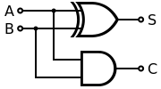
Logical – Half Adder
For binary arithmetic, XOR is an adder
0 + 0 = 0; 0 xor 0 = 0
0 + 1 = 1; 0 xor 1 = 1
1 + 0 = 1; 1 xor 0 = 1
1 + 1 = 2; 1 xor 1 = 0
Wait! 2 is not equal to zero!
But there is no “2” in binary, so it is expressed as 10 <one-zero>
Soooooo, the last digit is a ZERO as in the 1 xor 1
The 1 in the 2’s place is the carry out of adding 1 + 1
1 + 1 = zero, carry the one ➔ 10
Just like in decimal arithmetic: 1 + 9 = ten == 0 carry the 1 → 10
We can generate a carry in hardware by AND’ing the two inputs
Only when they are both one is the result a 1
1 and 1 = 1

Slide 8
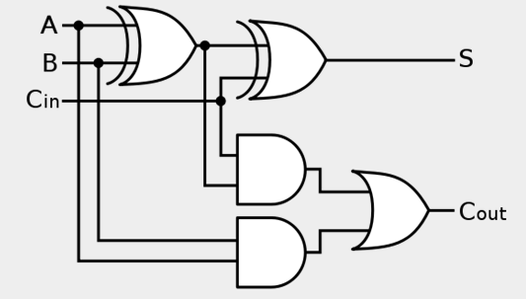
Hardware: Full Adder
The prior circuit was a one-bit half adder because it did not allow for a carry in
Adding a carry in and a little extra circuitry, we construct a one-bit full adder as shown below

Slide 9
Hardware: 4-Bit Full Adder
For multiple bits, cascade them together in parallel
Shown is a 4-bit full adder
But what about subtraction?
Of course we can build a subtractor
But better is to invert the sign of the
B input (i.e. neg B)
Taking two’s complement requires
inverting all the bits and adding one
XOR is a controllable inverter

Slide 10
Hardware: Addition & Subtraction
Initial carry in is the Add One
But what about subtraction?
Tie the first carry in to an
“Add/Sub” signal
If that is a ONE, all the bits
will be inverted and
we will add the negative

Slide 11
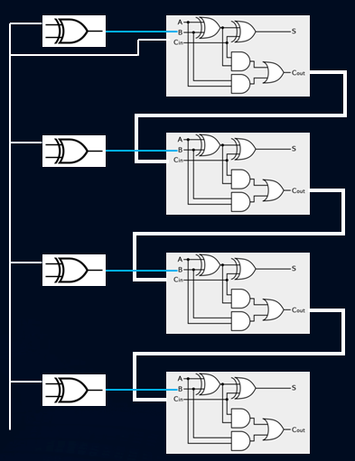

Sign Flag in Hardware
SF – Most Significant Bit (MSB)
With a 4-bit adder, this is bit #3
Remember the Jedi mind trick:
Always start with ZERO
Bit #0 is the Least Significant Bit (LSB)
How do we know this is the MSB?
C_{in}

Slide 12
Carry Flag in Hardware
CF – Most significant carry out with a twist
I only recently realized the twist
FINALLY found validation online – most sources don’t mention it
If just an adder, then most significant carry out, BUT …
If subtractor, must flip it when subtracting!
C_{in}

Slide 13
Zero Flag in Hardware
ZF – Is a one when result is zero
Must capture ALL SUM bits to know if zero
An “OR” gate will be zero if all zeros – one in any other case
We want one, oh what can we do?
C_{in}

Slide 14
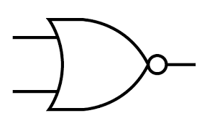
Zero Flag in Hardware
ZF – Is a one when result is zero
Must capture ALL SUM bits to know if zero
An “OR” gate will be zero if all zeros – one in any other case
We want one, oh what can we do?
NOT OR → NOR!
C_{in}

Slide 15
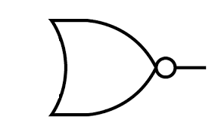
Zero Flag in Hardware
ZF – Is a one when result is zero
Must capture ALL SUM bits to know if zero
An “OR” gate will be zero if all zeros – one in any other case
We want one, oh what can we do?
NOT OR → NOR!
C_{in}

Slide 16
Overflow Flag in Hardware
OF – Detects carry out for a signed number
When the two most significant carry out values are different, overflow has occurred
C_{in}

Slide 17
Other Hardware Components
Multiplexer
Demultiplexer
Encoder
Decoder
D Flip Flop
Gated
Positive edge-triggered
Negative edge-triggered
Registers
Shift Register
Counter
Transmission Gate

Slide 18
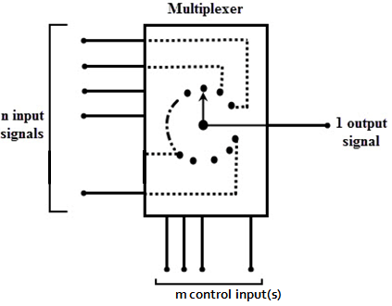
Multiplexer
A multiplexer selects one of many inputs to be routed to the output
n = number of inputs
m = number of control bits
Log₂(n) = m
2^{m} = n

Slide 19
Multiplexer
How many control bits required by a 4-to-1 mux?
How many control bits required by a 8-to-1 mux?
How many control bits required by a 16-to-1 mux?

Slide 20
Multiplexer
How many control bits required by a 4-to-1 mux?
2
How many control bits required by a 8-to-1 mux?
How many control bits required by a 16-to-1 mux?

Slide 21
Multiplexer
How many control bits required by a 4-to-1 mux?
2
How many control bits required by a 8-to-1 mux?
3
How many control bits required by a 16-to-1 mux?

Slide 22
Multiplexer
How many control bits required by a 4-to-1 mux?
2
How many control bits required by a 8-to-1 mux?
3
How many control bits required by a 16-to-1 mux?
Are you kidding? If YOU can’t figure this one out by now, drop the class!

Slide 23
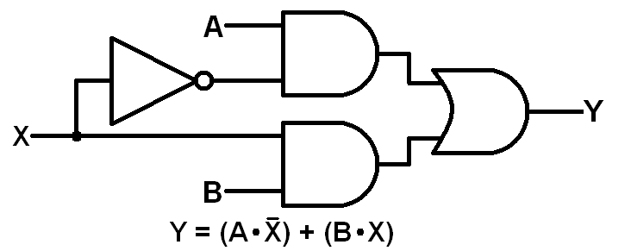
Multiplexer
A simple “mux” selects between 1 of 2 inputs
One control bit is used, it is either 0 or 1
Log₂(#inputs) = #control bits required
A 2-to-1 mux is shown below
When the ‘X’ control bit is zero, which input is routed to output ‘Y’?

Slide 24
Multiplexer
A simple “mux” selects between 1 of 2 inputs
One control bit is used, it is either 0 or 1
Log₂(#inputs) = #control bits required
A 2-to-1 mux is shown below
When the ‘X’ control bit is zero, which input is routed to output ‘Y’?
X = 0 disables B and enables A

Slide 25
Multiplexer
The full truth table for the 3 mux inputs is shown
What would we need to change such that X=1 would select the A input?
X | A | B | Y
0 | 0 | 0 | 0
0 | 0 | 1 | 0
0 | 1 | 0 | 1
0 | 1 | 1 | 1
1 | 0 | 0 | 0
1 | 0 | 1 | 1
1 | 1 | 0 | 0
1 | 1 | 1 | 1

Slide 26
Multiplexer
The full truth table for the 3 mux inputs is shown
What would we need to change such that X=1 would select the A input?
Put the X input directly to the A, AND gate
and the inverted X to the B, AND gate
X | A | B | Y
0 | 0 | 0 | 0
0 | 0 | 1 | 0
0 | 1 | 0 | 1
0 | 1 | 1 | 1
1 | 0 | 0 | 0
1 | 0 | 1 | 1
1 | 1 | 0 | 0
1 | 1 | 1 | 1
swap

Slide 27
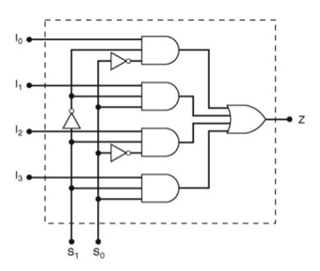
Multiplexer
4-to-1 Mux shown below
6 inputs, 4 data (I0 – I3), 2 control (S0, S1)
1 output, Z
How many entries required for a full truth table?
Let’s walk through the logic

Slide 28
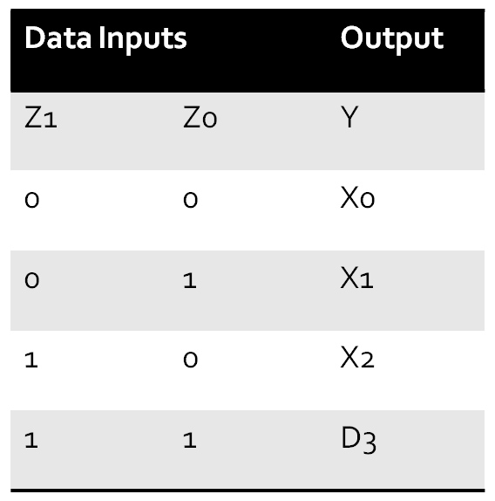
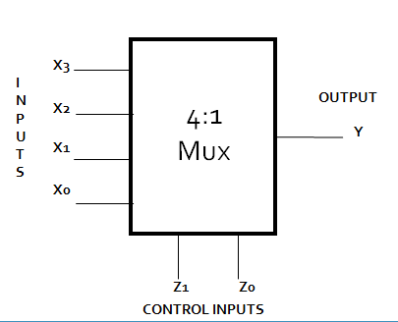
Multiplexer
You may also use a block diagram for a mux and use a truth table as shown

Slide 29
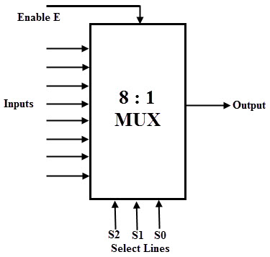
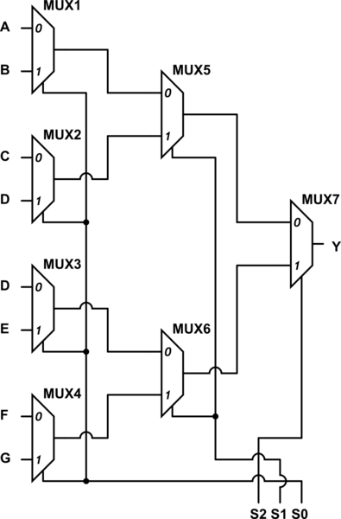
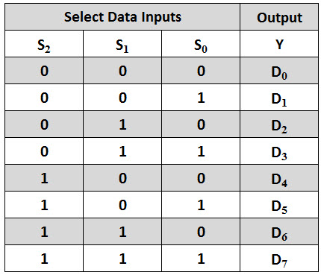
8-to-1 Multiplexer

Slide 30
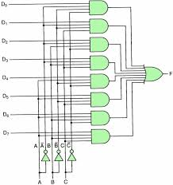
8-to-1 Multiplexer

Slide 31
Multiplexer
This slide intentionally blank …

Slide 32
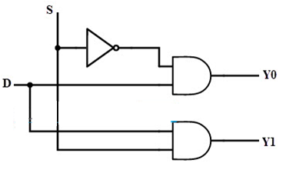
Demultiplexer
A “demux” performs the exact opposite function: routes one input to one of many outputs
A simple 1-to-2 Demux is shown
If the select line is zero, Y0 will be enabled (Y0==D) and Y1, disabled, Y1==0
If select is one, Y1 == D, Y0==0

Slide 33
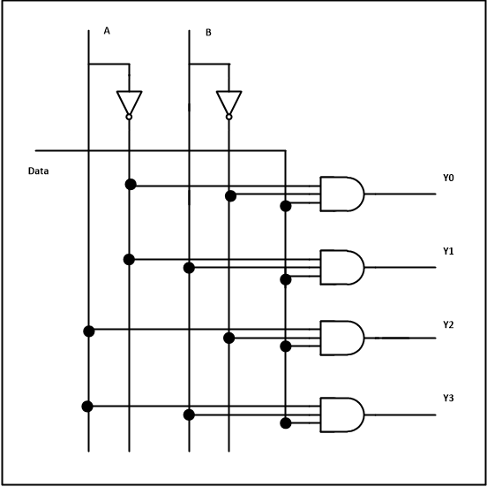
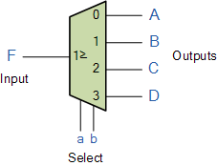
Demultiplexer
1-to4- Demux
In this case, ‘F’ is routed to either of A, B, C, D
Inputs a,b select which output
How many select lines if the
demux has 8 outputs?

Slide 34
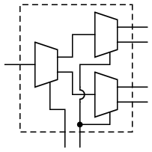
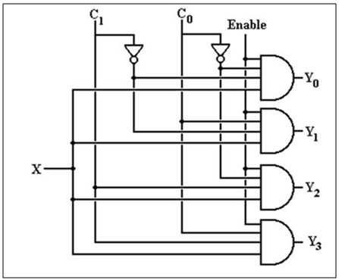
Demultiplexer
1-to4- Demux can also be made with 3, 1-to-2 demuxes
The right most image shows a demux with enable

Slide 35
Demultiplexer
This slide intentionally blank …

Slide 36
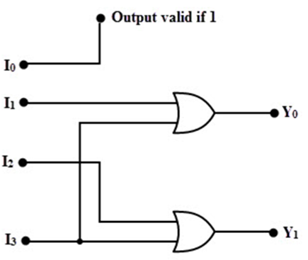
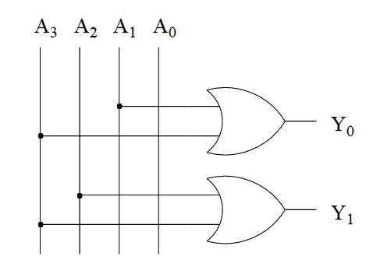
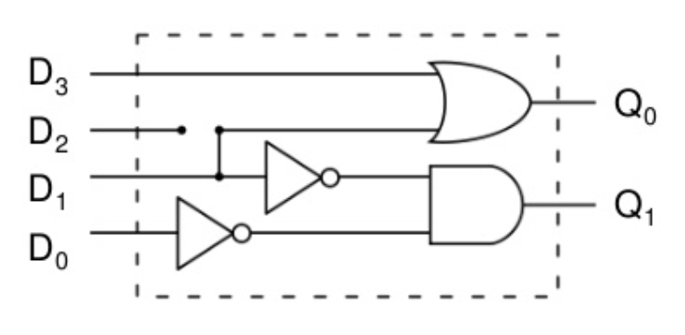
Encoder
An encoder takes multiple input lines and based on the one that is asserted, converts it to a binary number
A few implementations
The assumption is that only one of the inputs is high and the rest are low
The middle one is supposed to be a “priority” encoder. If A3 is high, the rest don’t matter. If A2 is high (and A3 is low) the rest should not matter, BUT A1 does – let’s fix it!

Slide 37
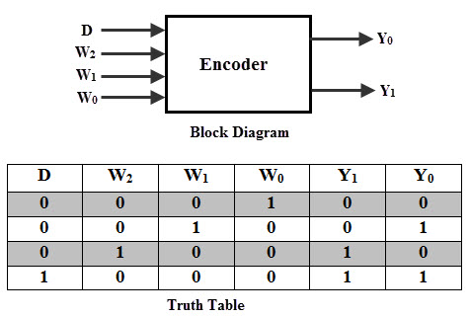
4-to-2 Encoder
High level block diagram and truth table
I do not know why one of the inputs is labeled ‘D’

Slide 38
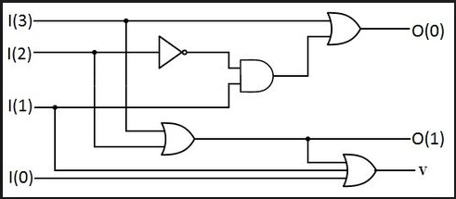
4-to-2 Priority Encoder
High level block diagram and truth table
If I3 is a one, output will be 11₂.
If I2 is a one (I3 is low of course, since it has priority), then I1 and I0 don’t matter, output is 10₂.
One application might be a peak level detector

Slide 39
Encoder
This slide intentionally left blank …

Slide 40
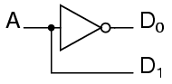
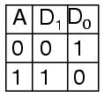
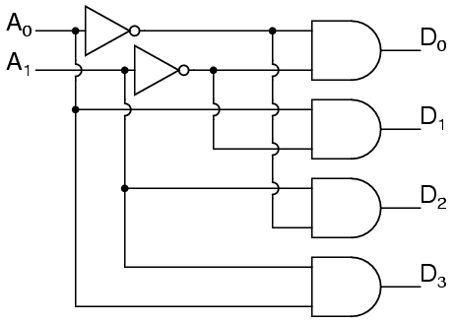
Decoder
A decoder takes a binary number input and sets one output high <or low> based on that number
A simple 1-to-2 decoder circuit
If A is a zero, D0 is a one, otherwise D1 is a one
A 2-to-4 Decoder should look familiar
➔ What is that ➔

Slide 41
Decoder
And check this out … our prior 4-to-1 mux
DECODER
MUX
DEMUX

Slide 42
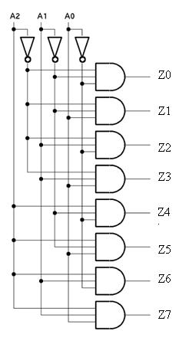
Decoder
3-to-8 Decoder

Slide 43
Decoder
This slide intentionally left blank …

Slide 44
Flip Flops
A flip flop is a device that can store 1 bit
It is NOT memory – memory is a different (multiple) technologies
There are also latches, which are similar to flip flops, the difference being is that a flip flop is clocked
Latches are asynchronous – no clock
Flip flops are synchronous with a clock
There are several types of flip flops
S-R flop flop (Set / Reset)
D flip flop (Data)
T flip flop (Toggle)
The D flip flop is the building block of registers so that is our focus

Slide 45
Flip Flops
The circuits we have studied thus far are “combinational”
Means that when the input changes, a short time later, the output changes
I say “a short time” because physical circuits, fast as they are, take physical time to change states
The time it takes for the output to change, once the input changes, is called “propagation delay”
Today, these delays are on the order of nanoseconds

Slide 46
Flip Flops
Latches and flip flops are not combinational
They are sequential and their inputs depend on their outputs
This is called feedback – tying an output back to an input
What do you think would happen in the following circuit?

Slide 47
Flip Flops
Latches and flip flops are not combinational
They are sequential and their inputs depend on their outputs
This is called feedback – tying an output back to an input
What do you think would happen in the following circuit?
It would oscillate with a period of the propagation delay
Frequency (Hz) = 1 / period (seconds) == cycles/second
f = 1 / T
A low input yields a high output which now becomes the input which leads to a low output which now …
T

Slide 48
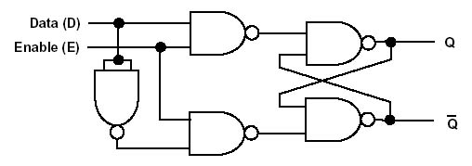
Flip Flops
D Latch – Let’s analyze
D Flip Flop – Let’s analyze

Slide 49
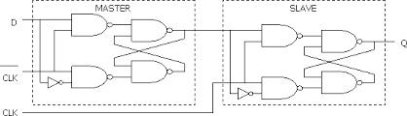
Master-Slave D Flip Flop
Those were great but we want to be able to write at the same time we are reading
One way is to cascade two flip flops together
This is called the master-slave configuration
This is a 1 bit register
It is called “edge-triggered”
More precisely, positive edge-triggered since the output changes with the rise of the clock
Note: this is
“NOT” clk,
- the inverse
of clk

Slide 50
Master-Slave D Flip Flop
When the clock is low, the slave is in “latch” mode and does not accept input
The master changes as the input D changes
When the clock goes high, the master is latched and the slave changes according to the master
This is called “edge-triggered” as the slave changes when the clock rises
How would we make it negative edge-triggered?

Slide 51
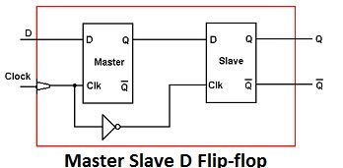
Master-Slave D Flip Flop
The flip flop is often shown as below
This appears to be positive edge-triggered flip flop, but you really can’t tell without seeing the internal circuitry
The truth table shows how the changes in clock affect the outputs
Clock | D | Q | Q not | Description
↓ >>0 | X | Q | Q | No Memory change
↑>>1 | 0 | 0 | 1 | Reset Q>>0
↑>>1 | 1 | 1 | 0 | Set Q>>1
1
2

Slide 52
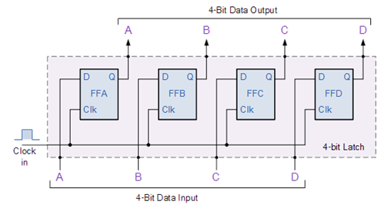
4-Bit Register
By cascading edge-triggered flip flops, we create a register
The term “latch” is used incorrectly in this diagram as there is a clock
A 4-bit register is shown
Can anyone figure out how to make a 32-bit register?

Slide 53
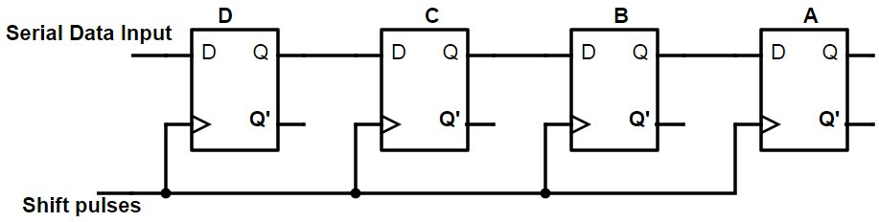
4-Bit Shift Register
As each clock pulses, the flip flop on the right gets the data from the flop flop to its left
For a logical shift, the data in will be zeros
For an arithmetic shift, the data in will be … you tell me?

Slide 54
4-Bit Shift Register
As each clock pulses, the flip flop on the right gets the data from the flop flop to its left
For a logical shift, the data in will be zeros
For an arithmetic shift, the data in will be … you tell me?
No
No
Yes!
I figured there would be a few wrong answers and then a correct one

Slide 55
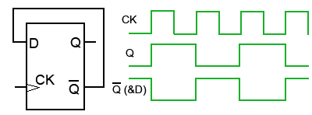
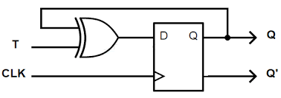
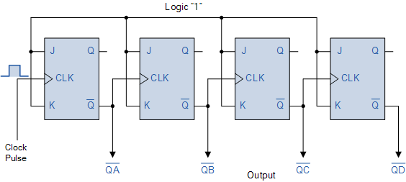
Toggle Flip Flop & Counters
A couple of ways to make a toggle flip flop
For the counter below, which flip flop is the MSB?

Slide 56
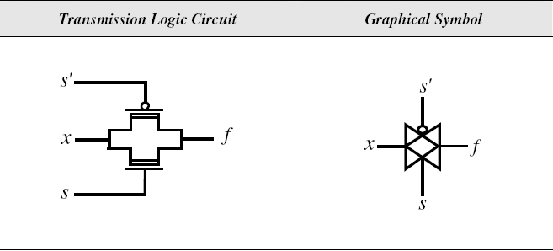
Transmission Gate
A transmission gate is nothing more than a switch
When the switch is closed, the T-gate allows the signal through
When the switch is open, the signal is blocked
The difference between this and enabling a combinational circuit is that the output is “high impedance” when the switch is off
It’s as if there is no circuit there
You can connect multiple outputs and not interfere with each other

Slide 57
Summary of Skills
Logical Operations & Relevant Hardware
i.e. What IS on the test!!!

Slide 58
Questions & Comments

Slide 59
References
My brain

